Slide 1
Data Base

Slide 2
What is Data?
Data is raw, unorganized facts that need to be processed. Data can be something simple and seemingly random and useless until it is organized.
Data Base.
An organized collection of related information so that it can be easily accessed, managed and updated.
Properties of Data Base.
It is a representation of some aspect of the real world or a collection of data elements (facts) representing real-world information.
A database is logical, coherent and internally consistent.
A database is designed, built and populated with data for a specific purpose.
Each data item is stored in a field.
A combination of fields makes up a table. For example, each field in an employee table contains data about an individual employee.

Slide 3
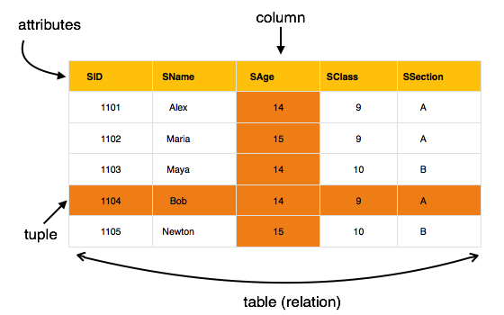
Database Fundamentals
Row
A row—also called a tuple—represents a single, implicitly structured data item in a table.
Column
The columns in a table are the set of facts that we keep track of about that type
of object. A column is also called an attribute.
Relation
Row
A row—also called a tuple—represents a single, implicitly structured data item in a table.
Column
The columns in a table are the set of facts that we keep track of about that type
of object. A column is also called an attribute.
Relation
Row
A row—also called a tuple—represents a single, implicitly structured data item in a table.
Column
The columns in a table are the set of facts that we keep track of about that type
of object. A column is also called an attribute.
Relation
Row
A row—also called a tuple—represents a single, implicitly structured data item in a table.
Column
The columns in a table are the set of facts that we keep track of about that type
of object. A column is also called an attribute.
Relation
Row
A row—also called a tuple—represents a single, implicitly structured data item in a table.
Column
The columns in a table are the set of facts that we keep track of about that type
of object. A column is also called an attribute.
Relation
A relation in a database means a 'TABLE'.
Tables are something which is made up of rows and columns.

Slide 4
Database Fundamentals
Database Model
A database model is a type of data model that determines the logical structure of a database and fundamentally determines in which manner data can be stored, organized and manipulated. The most popular example of a database model is the relational model, which uses a table-based format.
Query
A database query is a request for data from a database.
Views
A database view is a searchable object in a database that is defined by a query.
Procedures.
A stored procedure(set of SQL statement) is a named collection of SQL statements and procedural logic i.e, compiled, verified and stored in the server database

Slide 5
Database Fundamentals
Normalization
Database normalization is nothing but organizing the tables and columns of the tables in such way that it should reduce the data redundancy and complexity of data and improves the integrity (accuracy and consistency) of data.
Constraints
Constraints are used to specify rules for data in a table.
Functions
The Database functions perform basic operations, such as Sum, Average, Count, etc., and additionally use criteria arguments.
Indexes
Indexing is defined as a data structure technique which allows you to quickly retrieve records from a database file

Slide 6
Database Fundamentals
Cardinality
The number of tuples or rows in a relation is termed as cardinality.
Degree
The number of attributes in a relation determines the degree of relation. A relation having three attributes is said to have a relation of degree 3.

